Slide 1
Exp 8 and 9
Decoder and Encoder

Slide 2
Encoders and Decoders
Encoders and Decoders are Combinational, MSI (Medium-Scale Integration) Circuits.
Binary code of N digits can be used to store 2^{N} distinct elements of coded information.
This is what encoders and decoders are used for.
Encoders convert 2^{N} lines of input into a code of N bit and
Decoders decode the N bits into 2^{N} lines.

Slide 3
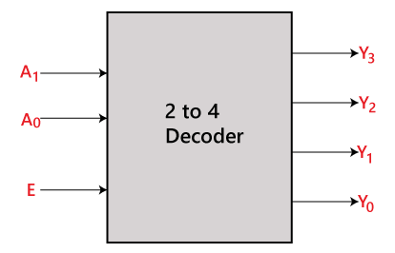
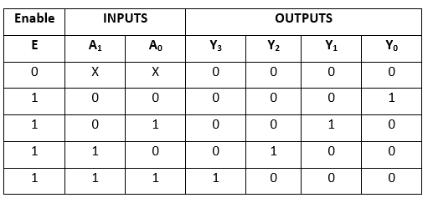
2 to 4 Line Decoder
In the 2 to 4 line decoder, there is a total of three inputs, i.e., A₀, and A₁ and E and four outputs, i.e., Y₀, Y₁, Y₂, and Y₃.
For each combination of inputs, when the enable 'E' is set to 1, one of these four outputs will be 1.
Truth Table

Slide 4
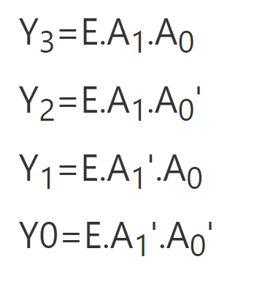
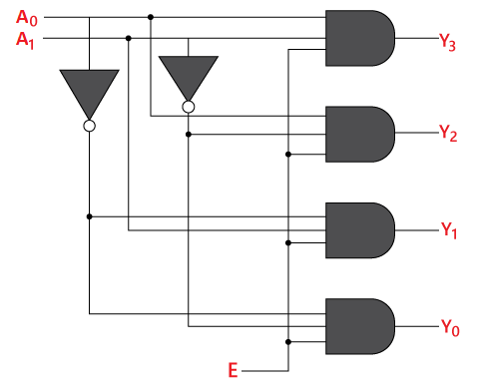
2 to 4 Line Decoder
The logical expression of the term Y₀, Y₁, Y₂, and Y₃ is as follows:

Slide 5
2 to 4 Line Decoder: Code
module decoder(a,b,c,d,e,f,E);
input a,b,E;
output c,d,e,f;
assign c = E&a&b;
assign d = E&a&(~b);
assign e = E&(~a)&b;
assign f = E&(~a)&(~b);
endmodule
module testbench;
reg a, b, E;
wire c,d,e,f;
decoder obj(a,b,c,d,e,f,E);
initial begin
$display("Inputs | Outputs");
$display("E a b | c d e f");
$monitor("%b %b %b | %b %b %b %b",E,a,b,c,d,e,f);
E=0 ; a=0; b=0;
#5 E=1; a=0; b=0;
#5 E=1; a=0; b=1;
#5 E=1; a=1; b=0;
#5 E=1; a=1; b=1;
#5 $finish;
end
endmodule

Slide 6
Decoders (3 to 8 line decoder)
Truth Table
A decoder does the opposite job of an encoder. It is a combinational circuit that converts n lines of input into 2^{n} lines of output.
Let’s take an example of 3-to-8 line decoder.
X | Y | Z | D0 | D1 | D2 | D3 | D4 | D5 | D6 | D7
0 | 0 | 0 | 1 | 0 | 0 | 0 | 0 | 0 | 0 | 0
0 | 0 | 1 | 0 | 1 | 0 | 0 | 0 | 0 | 0 | 0
0 | 1 | 0 | 0 | 0 | 1 | 0 | 0 | 0 | 0 | 0
0 | 1 | 1 | 0 | 0 | 0 | 1 | 0 | 0 | 0 | 0
1 | 0 | 0 | 0 | 0 | 0 | 0 | 1 | 0 | 0 | 0
1 | 0 | 1 | 0 | 0 | 0 | 0 | 0 | 1 | 0 | 0
1 | 1 | 0 | 0 | 0 | 0 | 0 | 0 | 0 | 1 | 0
1 | 1 | 1 | 0 | 0 | 0 | 0 | 0 | 0 | 0 | 1

Slide 7
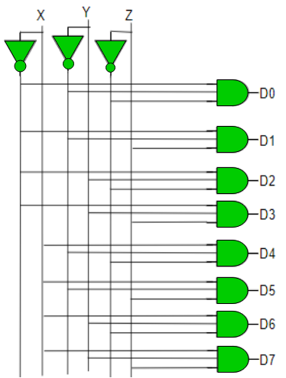
Decoders
Implementation –
D0 is high when X = 0, Y = 0 and Z = 0. Hence,
i.e. D0 = X’ Y’ Z’
Similarly,
D1 = X’ Y’ Z
D2 = X’ Y Z’
D3 = X’ Y Z
D4 = X Y’ Z’
D5 = X Y’ Z
D6 = X Y Z’
D7 = X Y Z

Slide 8
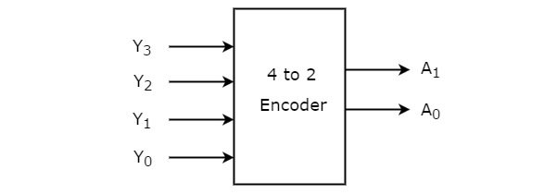
Encoder
An encoder is a combinational circuit that converts binary information in the form of a 2^{N} input lines into N output lines, which represent N bit code for the input.
For simple encoders, it is assumed that only one input line is active at a time.
4 to 2 Encoder
Let 4 to 2 Encoder has four inputs Y₃, Y₂, Y₁ & Y₀ and two outputs A₁ & A₀.
The block diagram of 4 to 2 Encoder is shown in the following figure.

Slide 9
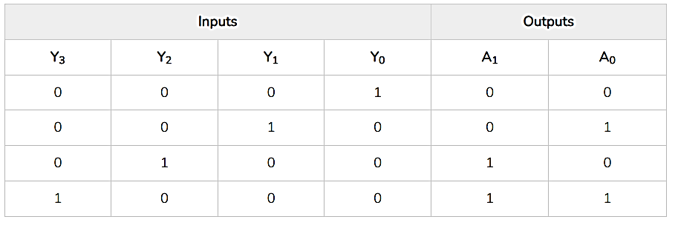
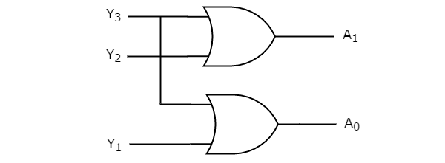


Encoder (4x2)
At any time, only one of these 4 inputs can be ‘1’ in order to get the respective binary code at the output.
The Truth table of 4 to 2 encoder is shown below.
From Truth table, we can write the Boolean functions for each output as

Slide 10
Encoder (4x2)
module encoder(a,b,c,d,p,q);
input a,b,c,d;
output p,q;
assign p = a | b;
assign q = a | c;
endmodule
module test;
reg a, b, c, d;
wire p,q;
encoder obj(a,b,c,d,p,q);
initial begin
$display("Inputs | Outputs");
$display("A B C D | P Q");
$monitor("%b %b %b %b | %b %b",a,b,c,d,p,q);
a=0; b=0; c=0; d=1;
#5 a=0; b=0; c=1; d=0;
#5 a=0; b=1; c=0; d=0;
#5 a=1; b=0; c=0; d=0;
end
endmodule

Slide 11
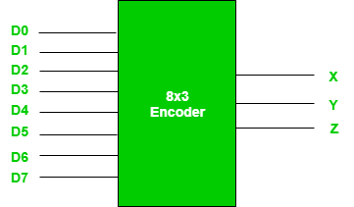
Encoder (8x3)
As an example, let’s consider Octal to Binary encoder. As shown in the following figure, an octal-to-binary encoder takes 8 input lines and generates 3 output lines.
Truth Table –
D7 | D6 | D5 | D4 | D3 | D2 | D1 | D0 | X | Y | Z
0 | 0 | 0 | 0 | 0 | 0 | 0 | 1 | 0 | 0 | 0
0 | 0 | 0 | 0 | 0 | 0 | 1 | 0 | 0 | 0 | 1
0 | 0 | 0 | 0 | 0 | 1 | 0 | 0 | 0 | 1 | 0
0 | 0 | 0 | 0 | 1 | 0 | 0 | 0 | 0 | 1 | 1
0 | 0 | 0 | 1 | 0 | 0 | 0 | 0 | 1 | 0 | 0
0 | 0 | 1 | 0 | 0 | 0 | 0 | 0 | 1 | 0 | 1
0 | 1 | 0 | 0 | 0 | 0 | 0 | 0 | 1 | 1 | 0
1 | 0 | 0 | 0 | 0 | 0 | 0 | 0 | 1 | 1 | 1
As seen from the truth table, the output is 000 when D0 is active; 001 when D1 is active; 010 when D2 is active and so on.

Slide 12
Encoder
Implementation – From the truth table, the output line Z is active when the input octal digit is 1, 3, 5 or 7.
Similarly, Y is 1 when input octal digit is 2, 3, 6 or 7 and X is 1 for input octal digits 4, 5, 6 or 7.
Hence, the Boolean functions would be:
X = D4 + D5 + D6 + D7
Y = D2 +D3 + D6 + D7
Z = D1 + D3 + D5 + D7

Slide 13
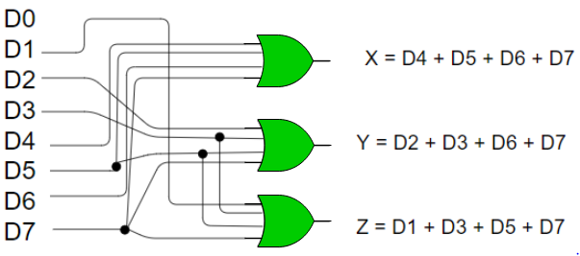
Encoder

Slide 14
Applications of Encoders and Decoders
Some of the significant applications are –
Speed Control of modern motors.
Night vision cameras
Metal detectors
encoder circuit has applications in Robotic vehicles
Automation system – especially the home automation system.
Automatic Monitoring systems has different types of encoder circuits.
Encoder circuit has utilized in encrypted communications system.

